Slide 1






S25' Training Sessions
mOBILE dEVELOPMENT
SESSION 9
#create_share_innovate

Slide 2





Table of contenet
Recap
API
JSON
S25' Training Sessions
API in Flutter

Slide 3



Recap
1.Basic Widgets
Scaffold, AppBar, Text , Buttons , Icons, TextField
2.Layout Widgets
Column, Row, Container, SizedBox, Center
3.Assets
Images, Fonts, Video, Audio
S25' Training Sessions

Slide 4
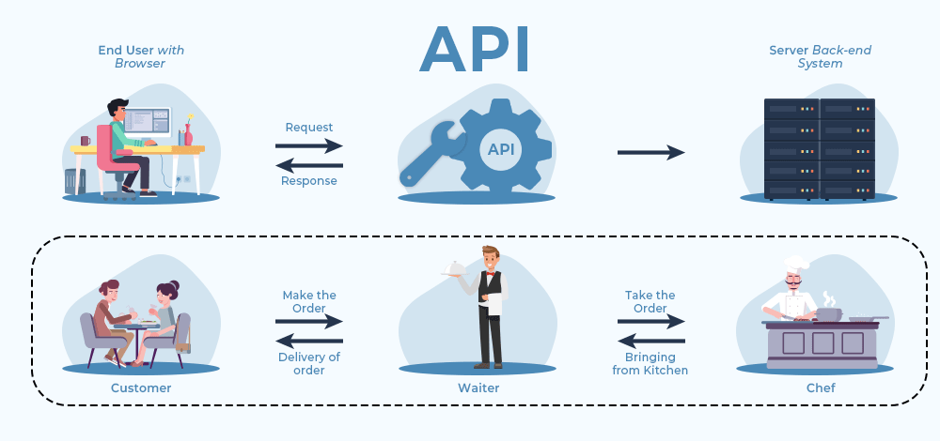
api
Application Programming Interface
S25' Training Sessions

Slide 5
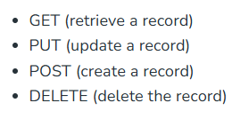
api methods
S25' Training Sessions

Slide 6
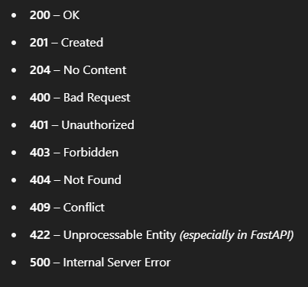
api HTTP Codes
S25' Training Sessions

Slide 7
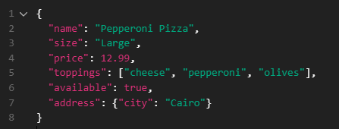
JSON
Stands for JavaScript Object Notation.
A way to store and exchange data — like sending information between a server and an app
S25' Training Sessions

Slide 8
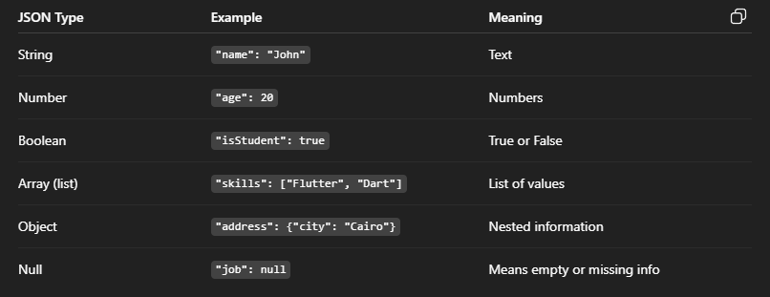
JSON Structure
S25' Training Sessions

Slide 9
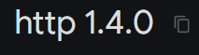
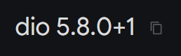
Api In flutter
http/dio package used for APIs
S25' Training Sessions

Slide 10
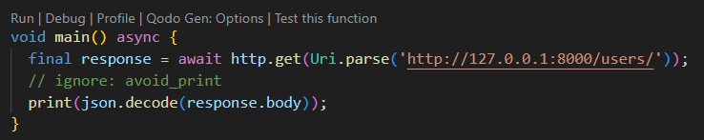
Api In flutter
S25' Training Sessions

Slide 11
Api In flutter
Future
S25' Training Sessions
A Future means:
"I will return a value later."
It represents a value that’s not available yet, but it will be in the future.

Slide 12
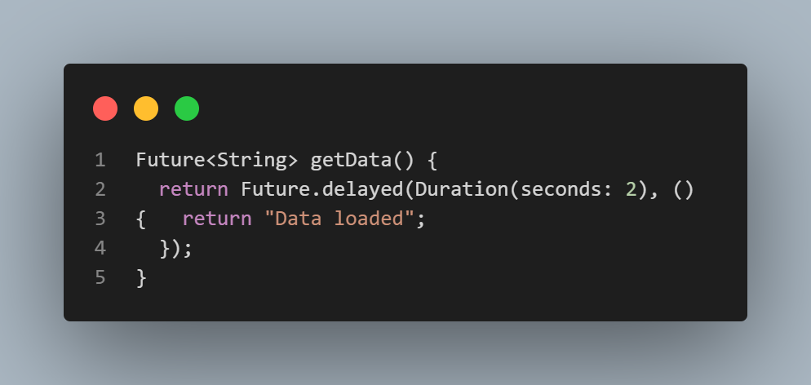
Api In flutter
S25' Training Sessions
This means: “Wait 2 seconds, and then return the string Data loaded.”

Slide 13
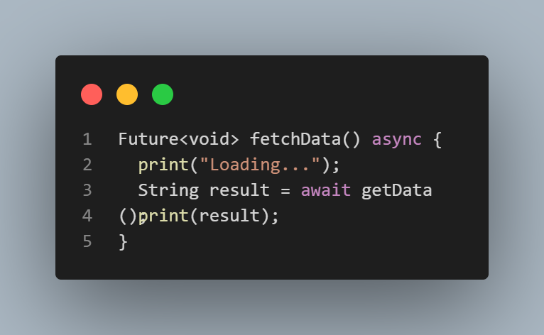
Api In flutter
async
You add async to a function to mark it as asynchronous (meaning it might take time and will return a Future).
S25' Training Sessions

Slide 14
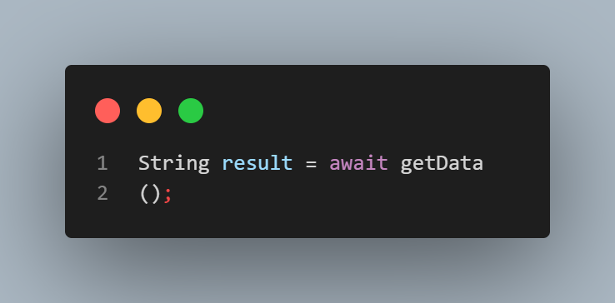
Api In flutter
await
You use await to pause the function and wait for the result of a Future, without freezing the whole app.
S25' Training Sessions
It waits for the getData() function to finish and stores the result in result.

Slide 15
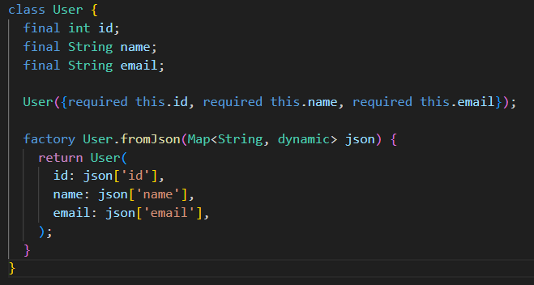
Api In flutter
Model are classes that are made to help decoding the json response to a map so it can easily be used in our app
S25' Training Sessions

Slide 16
Task
S25' Training Sessions
Weather App

Slide 17

tHANK YOU
SEE YOU NEXT TIME
S25' Training Sessions

